Slide 1
AI Local System 2026.5.10

Slide 2
Goal: From Engineer Configuration to Shop-floor UI-based Maintenance
Background: High Barrier for On-site Additions / Maintenance
Existing Camera System Standard Vision Solution
Stable for geometric measurement and rule-based inspection.
Engineers define workflow, ROI, thresholds, and decision rules.
Best for fixed products and stable inspection items.
Gap in Shop-floor Self-maintenance
Users avoid code and low-level algorithm flows.
For added checks, batch changes, or fixture changes, they expect UI-based handling.
Teach-in style: sample, mark ROI, learn, inspect.
Customer Needs:
UI Operation
Add Samples
Adjust ROI
Fast Launch
Add a self-configurable AI inspection tool for wrong / missing / reversed assembly.

Slide 3
Training Difference: CNN Training vs Sample Registration
Conventional CNN Training
Small-sample Registration
Train the classifier head or full network; weights change.
CNN weights stay fixed; only product feature prototypes are built.
Data
Usually requires many OK/NG images.
A few OK/NG samples are enough.
Weights
Backpropagation updates model parameters.
Official pretrained weights remain fixed.
Process
Train, validate, tune, and redeploy.
Forward inference extracts embeddings and computes prototypes.
Output
A retrained classification model.
OK/NG feature bank + OK/NG prototypes.
Maintain
Depends on algorithm engineers and training environments.
Users can add samples, adjust ROI, and relearn via UI.
Pretrained
Weights
Feature
Extraction
OK/NG
Prototype
Similarity
Check
Key point: “training” here means sample registration, not CNN training.

Slide 4
Solution Overview: Low-cost CCD + Registration Software
Domestic Camera
+ Light
OK/NG
Image Capture
ROI Setup
OK/NG
Registration Model
Line Inspection
Result Output
Low cost
Supports domestic cameras and lowers hardware cost.
Teach-in
Add samples, mark ROI, and click Learn like configuring a smart sensor.
Self-maintenance
Missing/wrong assembly inspection can be maintained by adding samples on site.

Slide 5
Do not use “retraining an OK/NG classifier head” as the fast-launch path.
Core Algorithm: Pretrained Features + Registration + Similarity
Why this approach?
The classifier head answers ImageNet categories, not current-part OK/NG.
Keep features and quickly adapt with a few samples.
Pretrained CNN
features
Edges / Textures / Shapes
ImageNet
Classifier Head
Not Used
ROI Image
224×224
GAP + L2 Normalization
Generate a stable embedding.
OK/NG Prototypes and Similarity
Judge whether it is closer to OK or NG.
Keep General Vision Features
Edges, textures, and shapes remain reusable.
Remove the Classifier Head
No category output.
Register with Product Samples
Build OK/NG prototypes for the current product.
1
2
3

Slide 6
Hardware Configuration and On-site Test Speed
Hardware List (Dual-camera)
Hardware Connection
Category
Model
Qty
Camera
MV-CX050-10WC
2
Cam1
Camera
PC
Infer/IO
Power Cable
MV-ACP-H6p-open-ST-3m
2
Line Output
OK/NG
Ethernet
MV-ACG-RJ45s-RJ45-ST-3m
2
Cam2
Camera
Light Source
MV-LRDS-120-90-W
2
Lens
MVL-MF1228M-8MP
1
Lens
MVL-MF2528M-8MP
1
PC
NP-6133-I6I16O-103008G+SSD128G
1
Cam1: Acq 62.6 Match 254.3 Infer 189.5 Total 506.4 ms
Domestic hardware lowers cost;
dual cameras cover multi-view inspection.
Cam2: Acq 63.7 Match 302.9 Infer 128.4 Total 495.0 ms
Single-camera Test Time
Approx. 500 ms
Breakdown
Capture + match + inference

Slide 7
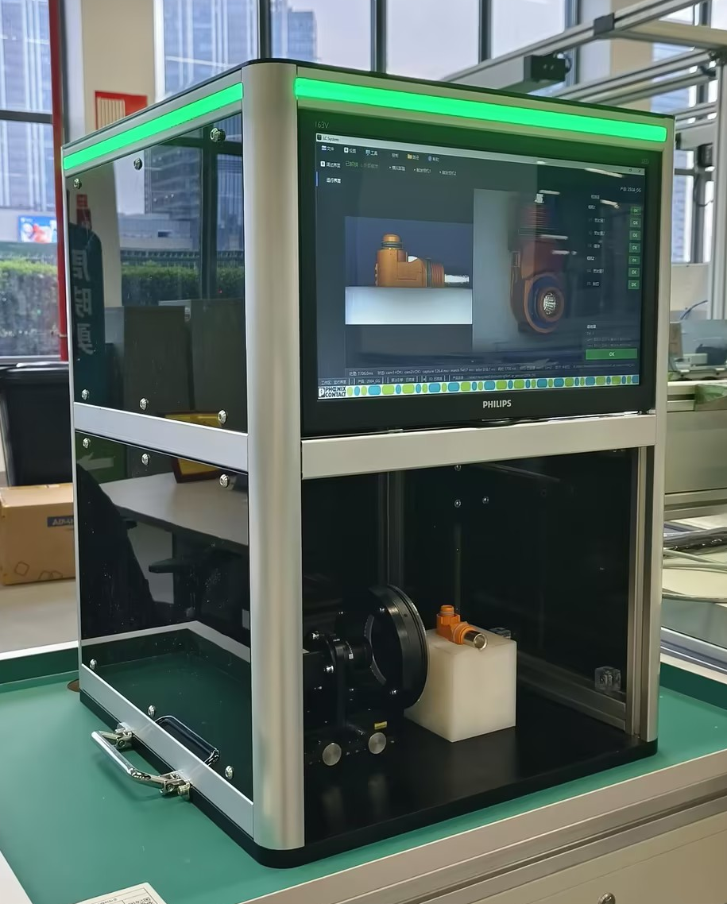
Overall Appearance
Status and inspection result indicators
Translucent Housing
AI Vision Inspection System
Optical components, multi-camera support
Compatible with quick-change fixtures

Slide 8
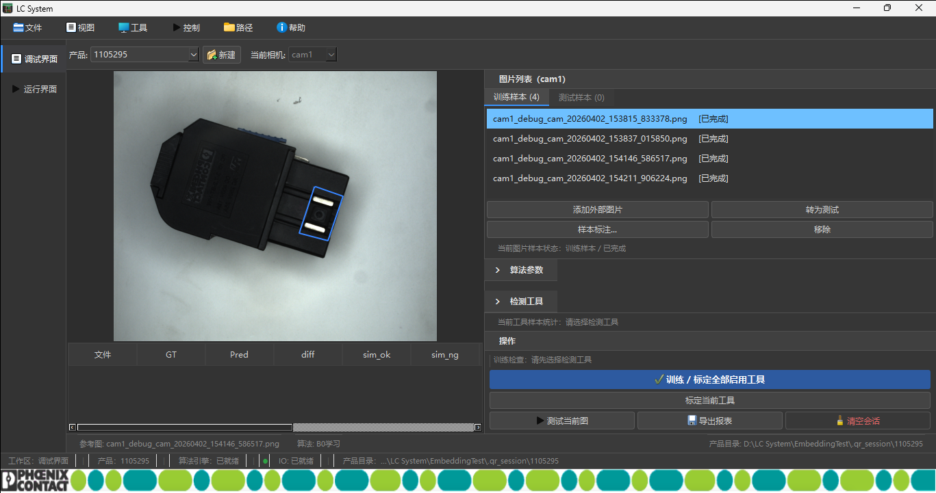
UI Overview
Menu Bar
Debug Interface
Add Sample Images
Select Tool Type
Register
Test

Slide 9
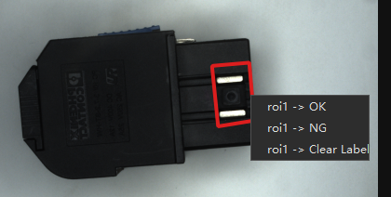
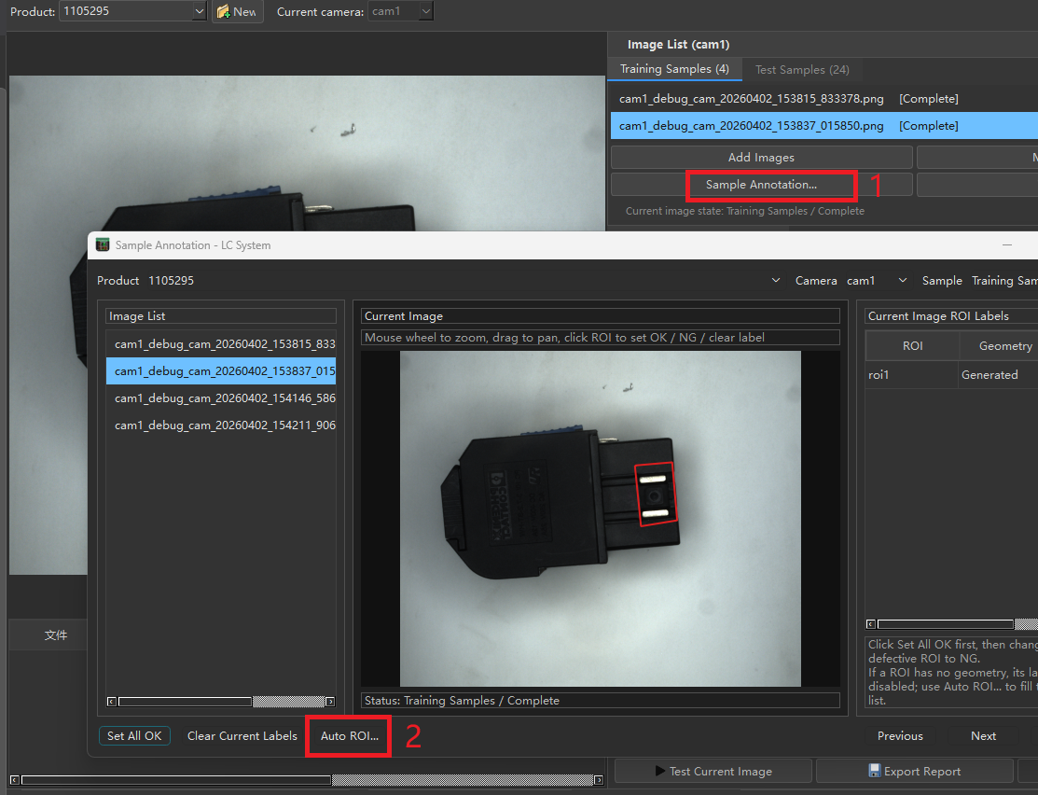
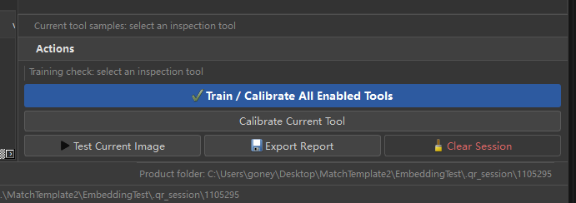
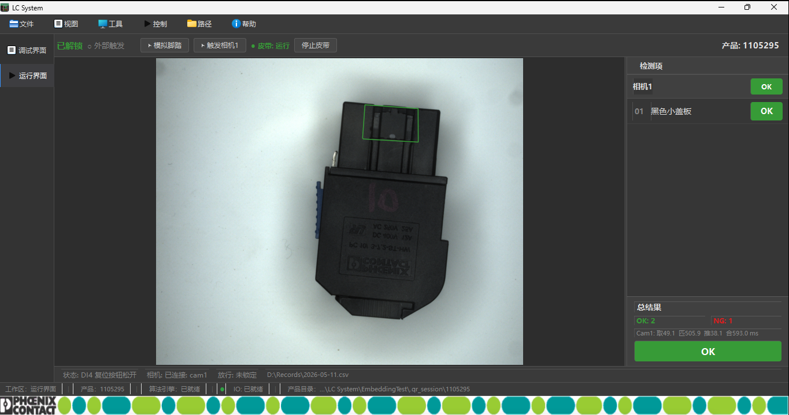
Operation Flow: Registration and Inspection
Add OK / NG Samples
Select Matching and Learning Areas
Start Learning
Start Inspection
1
2
3
4
Add OK/NG Samples
Select ROI Area
Click Learn
Start Inspection
Shop-floor User Tasks
Capture samples, mark ROI, add edge cases, and trigger relearning.
System Automatically Handles
Extract embeddings, build the feature bank, and perform similarity judgment.

Slide 10
Traditional Camera System vs Registration Learning System
Traditional Camera System
Small-sample Registration System
Maintenance
Engineers configure workflows, thresholds, and algorithm branches.
Maintenance
Users operate the UI, add samples, and relearn.
Changeover
Usually requires parameter retuning or development support.
Changeover
Quickly adapts by changing OK/NG samples and ROI.
Best for
Geometric measurement, strong rules, and long-term stable items.
Best for
Wrong, missing, and reversed assembly checks.
Use registration learning for judgments that need frequent maintenance and are hard to rule-code.

Slide 11
AI Local System

